Slide 1



50
40
30
FAKE NEWS DETECTION
USING KNOWLEDGE GRAPH
20
10
0
Item 1
Item 2
Item 3
Item 4
Item 5
AYUSH SINGH CHAUHAN
ROHIT GUPTA
SUBMITTED TO-
PROF. HRADESH KUMAR
181500180 Section - B -75
181500590 Section - B -76

Slide 2

Introduction
CONSEQUENCE
Some Big Examples of this issue is US Presidential election.
Tweeted Lie Triggers an Incidents.
Fake and misleading news stories related to medical treatments and major diseases like cancer or diabetes.
WHY
Widespread popularization of the internet made it convenient for people to get news from internet.
Unfortunately,open internet fuels spread of
a great many fake news.
Being of low Cost, easy access and rapid dissemination can lead to various issues.
APPROACH
Content-Based
Style Based

Slide 3
Problem Statement
AIM:
An important goal in improving the trustworthiness of information in online social networks is to identify the fake news timely, Our goal is to make a Fake News detector Model Using Knowledge Gate.
EXPECTED OUTCOME:
By calculating (Rp) reality parameters detecting whether a news is Fake or not, if exceeds a threshold value, an event is classified as real else fake.

Slide 4
Limitation to Pre-Existing Content Based Approaches
Can we incomplete and imprecise Knowledge Graph for fake
news detection?
What Happens if we don't have a Knowledge graph in the first place?
How can we use Knowledge Graph Embedding for fake news detection to reasonably
utilize the complete and precise knowledge graph related to the fake news topic we have?
Is the Single Model based on one related Knowledge Graph enough?

Slide 5
The Current Model
WE WILL DEVIDE OUR PROCESS TO BUILD THE CURRENT MODEL IN 4 STEPS
Building a knowledge Graph based base.
Using the Knowledge Graph to train TransE.
The Binary TransE Model
The Hybrid Approach
Basically we will use some of the Top used search APis For ex-Google,bing

Slide 6
DATASETS
WE ARE USING FAKE AND REAL NEWS DATASET FROM KAGGLE
About this file.
Contains two files
1) True.csv Containing True data.
2)False.csv Containing False data.
We have done quite a Preprorcessing and EDA of this Dataset to we can use it properly.

Slide 7
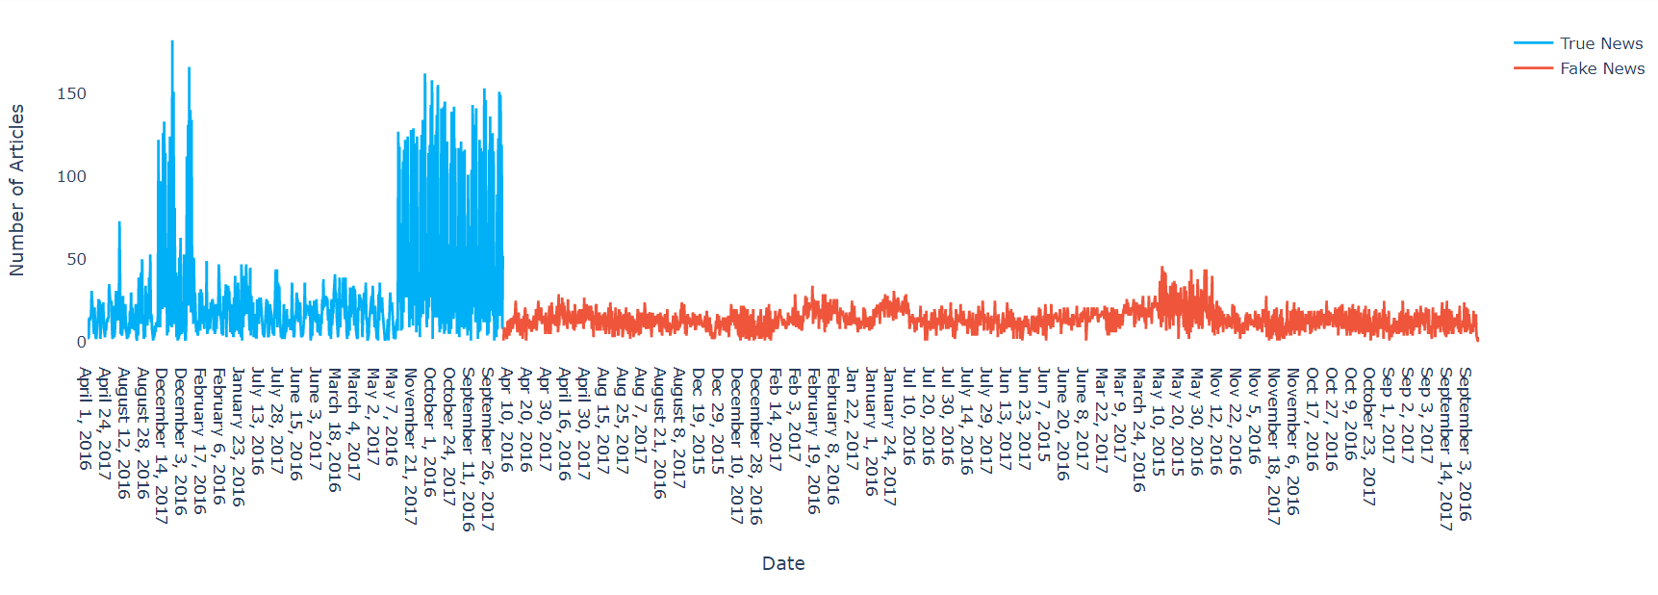
Exploratory Data analysis
HERE ARE SOME EDA INSIGHTS

Slide 8
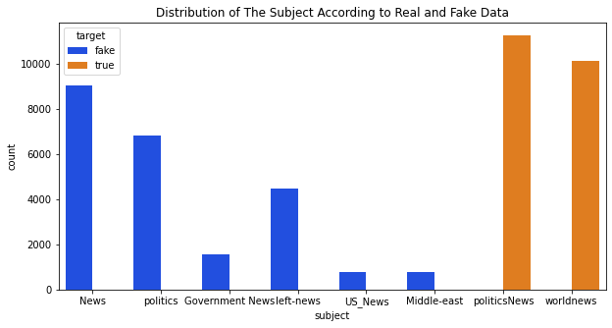
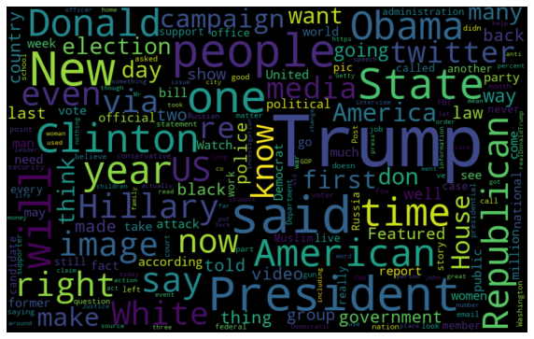
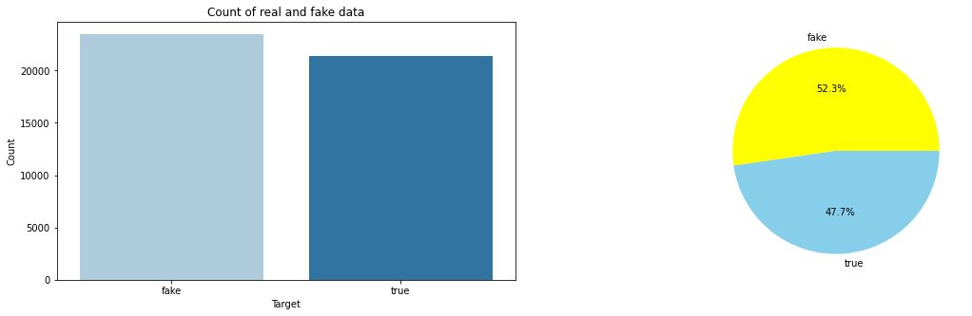

Slide 9
Generating Background Knowledge Base
WE PRODUCE THREE KNOWLEDGE GRAPHS:
Based on Fake News articals or our datasets.
Based on an External Knowledge Graph.
Based on True news articles from reliables source search APIs .
We Extract Triplets from the articles bases and use it to form Knowledge Graphs.
Ones Produced we train a single model on each one of them using TransE and Compare
their performance.

Slide 10
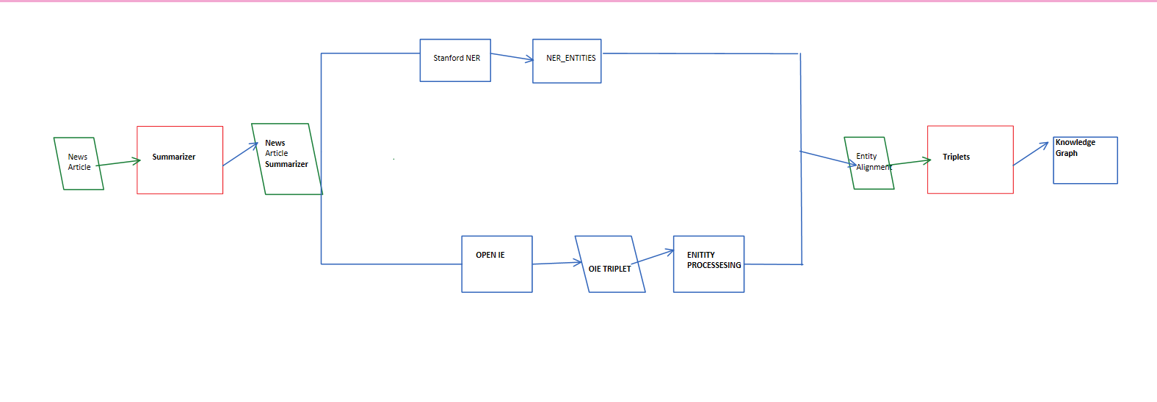
GENERATING BACKGROUND
KNOWLEDGE GRAPH
TRIPLET EXTRACTION FROM AN ARTICLE BASE

Slide 11
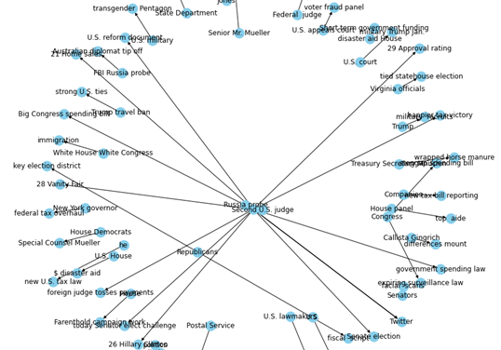
KNOWLEDGE GRAPH

Slide 12
The TransE Model
WE EXTRACT TRIPLETS FROM THE NEWS ARTICLE AND REPRESENT IT IN VECTOR SPACE TO JUDGE WHETHER THE ARTICLE IS FAKE OR NOT.
We Calculate the Bias of each triplets which is extracted.
For classification we use 2 Ways.
Avg Bias Classification
Max Bias Classification

Slide 13
The B-TransE Model
A Single TransE model to do classfication is not enough.
one model is trained based on triplet extracted from FAKE NEWS.
The other is trained with based on triplets extracted from true news.
We define a new bias formula based on baises calculated from both true & false triples;
classification way remains the same.
avg bias & max bias.

Slide 14
Hybrid Model
Improve detection performance
we use fusion strategy to combine features of vectors from different models.
we integrate different features first and then using those integrated features we classify.
max bias is used to do classification.

Slide 15
Conclusion
We tackled the problem of Fake News detection & with KG
We got know about difference b/w content based and style based fake news detection.
Limitations of PreExisting Model.
The Modern solution Approach.
1) Creating Background knowledge base.
2)Single TransE model
3)B-TransE model
4)Hybrid Approach with Help of Search Apis Like google and Bing calculating to check relevance.

